Slide 1

Variables in Property Market

Slide 2
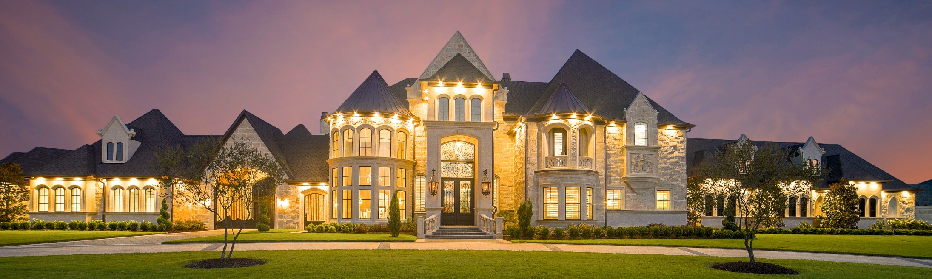
Back Story:
I am in market for a property.
What are the variables that affect my choice?
What are the key considerations?

Slide 3








Tools:
Data Source: Property Guru.com.sg
Use Load webpage
(Selenium and Chromedriver)
Parse Html (BeautifulSoup)
Find Tags and covert to text
(Python and JupyterNB)
Use Panda, Numpy and Seaborn for
Data manipulation and Display
Use sklearn and statsmodel to analyse, validate, train and test

Slide 4

Analysis
Exploratory Assessment of Data Set
Let’s try Linear Regression
Make Dummy Data
Validate, Train and Test with
Lasso Linear Regression
Ridge Linear Regression

Slide 5
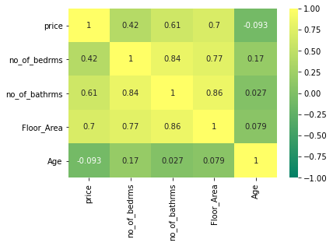

General overview of Data Set
1000 sample / 612 good ones/ 388 rejected
Heat Map
Variables
High correlation

Slide 6
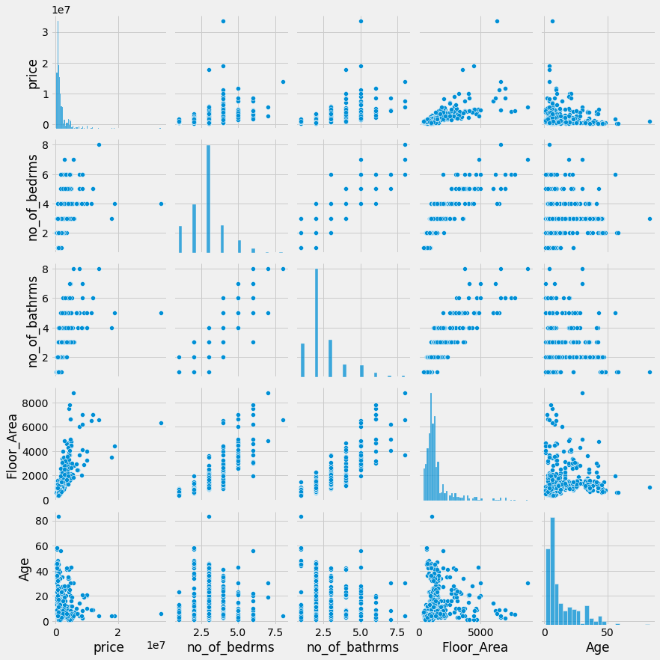
Pair Plot
?
Price VS Floor Area

Slide 7
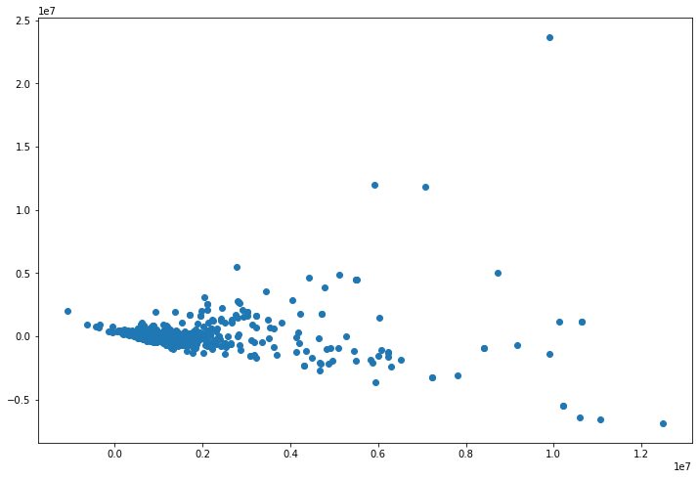
Ordinary Least squares Regression:
Skew: | 6.281 | Prob(JB): | 0.00
Kurtosis: | 87.534 | Cond. No. | 6.11e+03
Highly
Skewed
Scatter Plot: Price vs Floor Area
Outliers

Slide 8
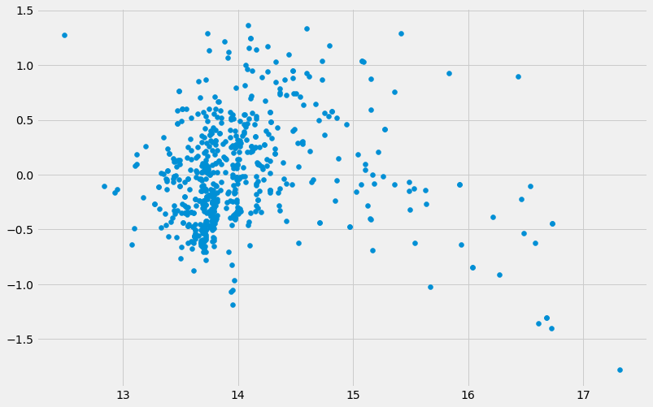
Taming the data:
Omnibus: | 12.900
Prob(Omnibus): | 0.002
Skew: | 0.307
Kurtosis: | 3.398
Taking Log on the Price data
Scatter Plot after Log Price
Getting
Better

Slide 9

Examining R2 (R’Sq)
OLS Initial : R2 = 0.553
After Log of $ : R2 = 0.639
After Log of both $ and Flr_Area : R2 = 0.721
Tried removing Features but R2 Decreased.
???

Slide 10

Let’s try Linear Regression:
Linear Regression Initial : R2 = 0.553 (same as OLS)
Less One Feature (Age) : R2 = 0.616 (vs 0.671 in OLS)

Slide 11
Making Dummy Data
Adding ‘Type ’ of Home to the Dataset via Patsy
R2 improved from 0.721 to 0.813
Condominium 271
HDB 199
Apartment 64
Terraced House 19
Executive Condominium 19
Semi-Detached House 15
Corner Terrace 11
Detached House 7
Bungalow House 3
Cluster House 3
Walk-up 1
Name: Type, dtype: int64

Slide 12

Train , Validate and Test (60,20,20)
Results for Simple Validation (sklearn)
Linear Regression Val R^2: 0.892
Ridge Regression Val R^2: 0.893
Deg 2 poly regression Val R^2: -5.510 poor-fit
Similar Results

Slide 13

Cross Validation
Results (using 5 splits in K- fold )
Simple mean cv r^2: 0.742 +- 0.103
Ridge mean cv r^2: 0.744 +- 0.099
Linear Regression test R^2: 0.778
Ridge Regression test R^2: 0.787
Similar Results

Slide 14
Lasso Linear Regression
Train Results
Target Y: Price Vs X:
Floor Area | 14.384
Num of Bedrooms | -0.0
Num of Bathrooms | 0.0
Age | -13283.08
FA2 | 6.289

Slide 15
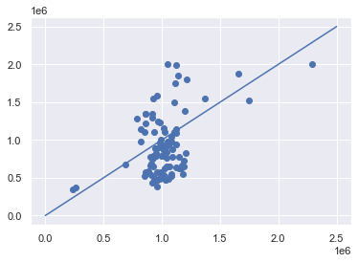
Lasso Linear Regression
Train Results R2: 0.118
MAE: 322.4k
(Mean Absolute Error)

Slide 16

Ridge Model Linear Regression
Cross Validation (using Ridge Model)
After Cross Val, Best Alpha : @ 5.415
MAE: 274.4k (vs Lasso MAE: 276.1k)
R2: 0.331 (vs Lasso R2: 0.327)

Slide 17

Conclusion:
Considerations for Buying Property
Price and Floor Area goes hand in hand
Age, Bedrooms and Bathrooms are not so important to the model but may be important to buyer.
Use Ridge Regression for better results

Slide 18

Improvements:
Include more Features such as Tenure and Area which the property is zoned in.
Increase sample size to 10~20k samples to “see the bigger picture”
To look into nearby amenities like good schools, places of interest, sports facilities, etc vs price

Slide 19

End of Presentation
Any Question?
Thank you for your time and attention
Follow me on linkedin:
https://www.linkedin.com/in/andrew-tan-41878671
https://github.com/guitarfly78

